Slide 1
Computer Organization Principles
School of Software, Dalian University of Technology
Chi Lin (林驰)
chilin@mail.dlut.edu.cn

Slide 2
Chapter 8: Control Unit
Control Unit Operation
Micro-Operations (微操作)
Control of the Processor
Micro-programmed Control (微指令控制)
Basic Concepts
Micro-instruction Sequencing(微指令时序)
Micro-instruction Execution(微指令执行)

Slide 3
Chapter 8: Control Unit
Control Unit Operation
Micro-Operations (微操作)
Control of the Processor
Micro-programmed Control (微指令控制)
Basic Concepts
Micro-instruction Sequencing(微指令时序)
Micro-instruction Execution(微指令执行)

Slide 4
Recall

Slide 5
Key Points
The execution of an instruction involves the execution of a sequence of substeps, generally called cycles.
For example, an execution may consist of fetch, indirect, execute, and interrupt cycles. Each cycle is in turn made up of a sequence of more fundamental operations, called micro-operations.
A single micro-operation generally involves
a transfer between registers,
a transfer between a register and an external bus,
or a simple ALU operation.

Slide 6
Key Points
The control unit of a processor performs two tasks: (1) It causes the processor to step through a series of micro-operations in the proper sequence, based on the program being executed, and (2) it generates the control signals that cause each micro-operation to be executed.

Slide 7
Key Points
The control signals generated by the control unit cause the opening and closing of logic gates, resulting in the transfer of data to and from registers and the operation of the ALU.

Slide 8
Key Points
One technique for implementing a control unit is referred to as hardwired implementation, in which the control unit is a combinatorial circuit. Its input logic signals, governed by the current machine instruction, are transferred into a set of output control signals.

Slide 9
Four Ambiguous Definitions
Micro-Command
Micro-Operation
Micro-Instruction
Micro-Program

Slide 10
Instructions and micro-operations
The operation of a computer, in executing a program, consists of a sequence of instruction cycles (指令周期), with one machine instruction per cycle.

Slide 11
Micro-Operations (微操作)
In computer central processing units, micro-operations (also known as a micro-ops or μops) are detailed low-level instructions used in some designs to implement complex machine instructions (sometimes termed macro-instructions in this context).

Slide 12
One instruction cycle, four units
The instruction cycle is made up of a number of smaller units. One subdivision that we found convenient is fetch, indirect, execute, and interrupt, with only fetch and execute cycles always occurring.
How about Fetch, Decode, Execute, Memory, Write Back ?
Yes, they are micro-instructions, but not typical.

Slide 13
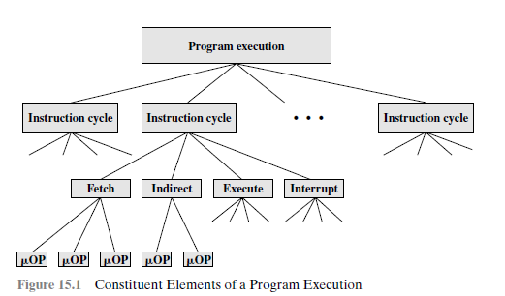

Slide 14
The Fetch Cycle
Memory address register (MAR): Is connected to the address lines of the system bus. It specifies the address in memory for a read or write operation.
Memory buffer register (MBR) / Memory Data register: Is connected to the data lines of the system bus. It contains the value to be stored in memory or the last value read from memory.
Program counter (PC): Holds the address of the next instruction to be fetched.
Instruction register (IR): Holds the last instruction fetched.

Slide 15
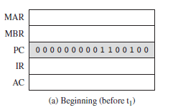
The Fetch Cycle
At the beginning of the fetch cycle, the address of the next instruction to be executed is in the program counter (PC); in this case, the address is 1100100.
The first step is to move that address to the memory address register (MAR) because this is the only register connected to the address lines of the system bus.

Slide 16
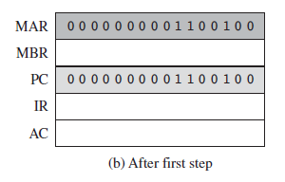
The Fetch Cycle
The second step is to bring in the instruction. The desired address (in the MAR) is placed on the address bus, the control unit issues a READ command on the control bus, and the result appears on the data bus and is copied into the memory buffer register (MBR).
Notes:
注意： CU 发出读的的指令， 才能从内存中读取相应的字符

Slide 17
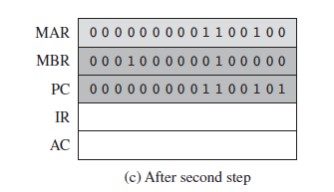
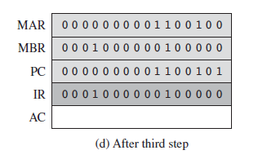
The Fetch Cycle
We also need to increment the PC by the instruction length to get ready for the next instruction.
The third step is to move the contents of the MBR to the instruction register (IR).This frees up the MBR for use during a possible indirect cycle.

Slide 18
The Fetch Cycle
Thus, the simple fetch cycle actually consists of three steps and four micro-operations. Each micro-operation involves the movement of data into or out of a register. So long as these movements do not interfere with one another, several of them can take place during one step, saving time.

Slide 19
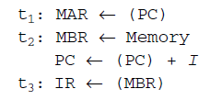
The Fetch Cycle
Symbolically, we can write this sequence of events as follows: where I is the instruction length.
First time unit: Move contents of PC to MAR.
Second time unit: Move contents of memory location specified by MAR to MBR. Increment by I the contents of the PC.
Third time unit: Move contents of MBR to IR.

Slide 20
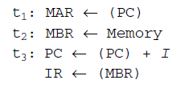
Feasible for both of them ?
Pc = (pc) + 1 不能放在第一个，因为不能同时执行造成指令过长，放在二三可同时执行
The answer is YES.
How to group micro-operations ??

Slide 21
How to group micro-operations ?
The groupings of micro-operations must follow two simple rules:
The proper sequence of events must be followed. Thus must precede because the memory read operation makes use of the address in the MAR.
Conflicts must be avoided. One should not attempt to read to and write from the same register in one time unit, because the results would be unpredictable.

Slide 22
The Indirect Cycle
Once an instruction is fetched, the next step is to fetch source operands. Continuing our simple example, let us assume a one- address instruction format, with direct and indirect addressing allowed. If the instruction specifies an indirect address, then an indirect cycle must precede the execute cycle.

Slide 23
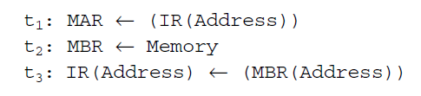
The Indirect Cycle
If the instruction specifies an indirect address, then an indirect cycle must precede the execute cycle.

Slide 24
The Indirect Cycle
The address field of the instruction is transferred to the MAR.
This is then used to fetch the address of the operand.
Finally, the address field of the IR is updated from the MBR, so that it now contains a direct rather than an indirect address.
The IR is now in the same state as if indirect addressing had not been used, and it is ready for the execute cycle. We skip that cycle for a moment, to consider the interrupt cycle.

Slide 25
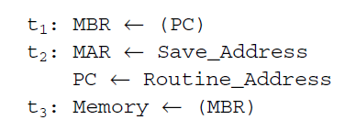
The Interrupt Cycle
At the completion of the execute cycle, a test is made to determine whether any enabled interrupts have occurred. If so, the interrupt cycle occurs.

Slide 26
The Interrupt Cycle
In the first step, the contents of the PC are transferred to the MBR, so that they can be saved for return from the interrupt.

Slide 27
The Interrupt Cycle
Then the MAR is loaded with the address at which the contents of the PC are to be saved, and the PC is loaded with the address of the start of the interrupt-processing routine.

Slide 28
The Interrupt Cycle
The final step is to store the MBR, which contains the old value of the PC, into memory.

Slide 29
The Execute Cycle
The fetch, indirect, and interrupt cycles are simple and predictable. Each involves a small, fixed sequence of micro-operations and, in each case, the same micro-operations are repeated each time around.
This is not true of the execute cycle. Because of the variety opcodes, there are a number of different sequences of micro-operations that can occur.

Slide 30
The Execution Cycle: ADD R1, X
Consider an add instruction: ADD R1, X
which adds the contents of the location X to register R1.

Slide 31
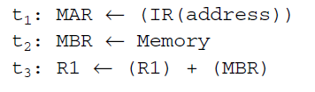
The Execution Cycle
We begin with the IR containing the ADD instruction.
In the first step, the address portion of the IR is loaded into the MAR.
Then the referenced memory location is read.
Finally, the contents of R1 and MBR are added by the ALU.

Slide 32
The Instruction Cycle
We assume a new 2-bit register called the instruction cycle code (ICC).
The ICC designates the state of the processor in terms of which portion of the cycle it is in:
00: Fetch
01: Indirect
10: Execute
11: Interrupt

Slide 33
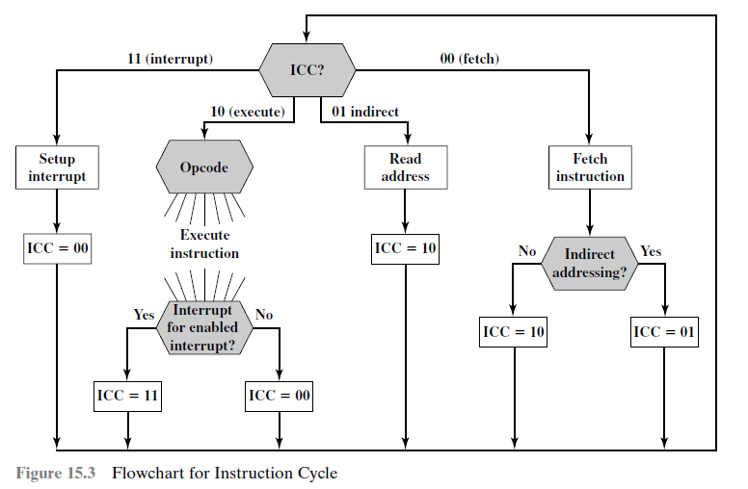
Flowchart for Instruction Cycle

Slide 34
Control of the Processor
A characterization of the control unit:
Define the basic elements of the processor.
Describe the micro-operations that the processor performs.
Determine the functions that the control unit must perform to cause the micro-operations to be performed.

Slide 35
Control Tasks
The control unit performs two basic tasks:
Sequencing: The control unit causes the processor to step through a series of micro-operations in the proper sequence, based on the program being executed.
Execution: The control unit causes each micro-operation to be performed.

Slide 36
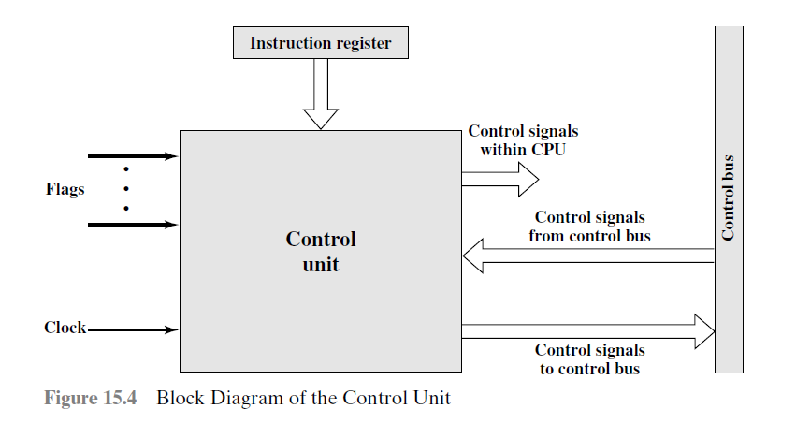
Control Signals

Slide 37
Input of CU
Clock: This is how the control unit “keeps time.” The control unit causes one micro-operation (or a set of simultaneous micro-operations) to be performed for each clock pulse. This is sometimes referred to as the processor cycle time, or the clock cycle time(时钟周期).

Slide 38
Input of CU
Instruction register: The opcode and addressing mode of the current instruction are used to determine which micro-operations to perform during the execute cycle.

Slide 39
Input of CU
Flags: These are needed by the control unit to determine the status of the processor and the outcome of previous ALU operations.

Slide 40
Input of CU
Control signals from control bus: The control bus portion of the system bus provides signals to the control unit.

Slide 41
Output of CU
Control signals within the processor: These are two types: those that cause data to be moved from one register to another, and those that activate specific ALU functions.

Slide 42
Output of CU
Control signals to control bus: These are also of two types: control signals to memory, and control signals to the I/O modules.

Slide 43
Control Signal Example
C₂
M D R
M D R
Fetch Cycle
AC
C₃
PC
PC
PC
IR
PC
IR
PC
C₀
ALU
Control
Signal
C₁
C₄
…
M A R
M A R
CU
CU
Flag
…
Clock
…
Control
Signal

Slide 44
Control Signal Example
间接寻址需要IR中的地址 但是不一定一定要从IR中读取，可以从MDR中读取上一条指令中的地址
C₂
Indirect Cycle
M D R
M D R
M D R
AC
C₅
IR
C₃
PC
IR
ALU
Control
Signal
C₁
…
M A R
M A R
CU
Flag
…
Clock
…
Control
Signal

Slide 45
Control Signal Example
C₂
Execution Cycle
M D R
M D R
M D R
AC
AC
C₅
PC
IR
C₆
C₈
C₇
Control
Signal
ALU
Control
Signal
ALU
…
C₁
…
M A R
M A R
CU
Flag
Control signal负责发送信号让ALU执行加的指令
…
Clock
…
Control
Signal

Slide 46
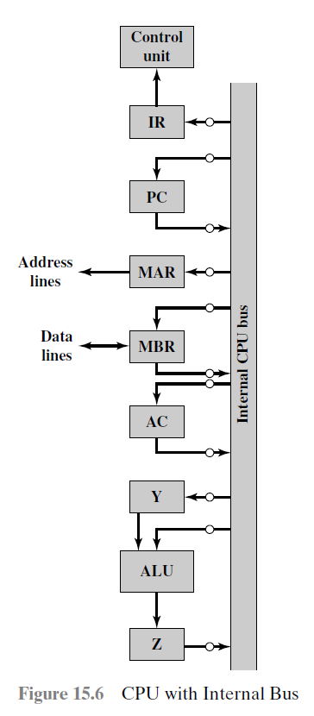
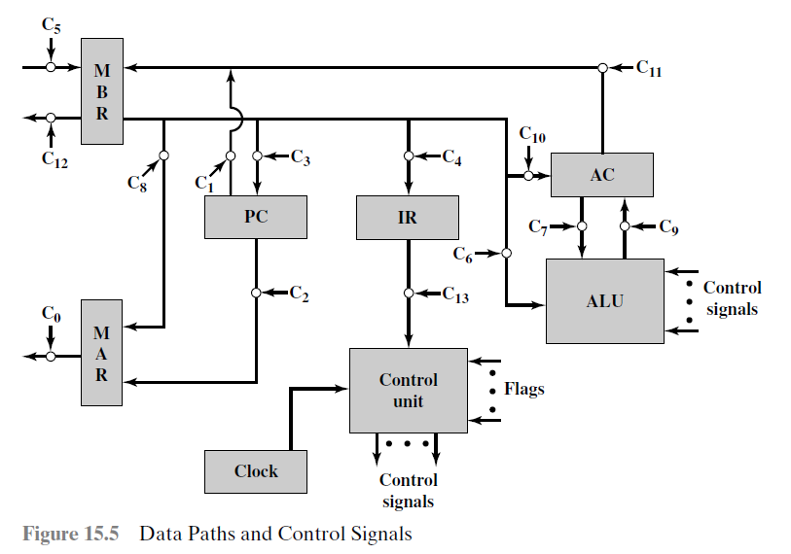
Internal Processor Organization
Using an internal processor bus, Figure 15.5 can be rearranged as shown in Figure 15.6.

Slide 47
Control Signal
…
ADD Fetch Cycle
CLK
CU
CU
CU
IR_{i}
IR
IR
IR
PC
MAR
AB
PC_{O}
MAR_{i}
PC
PC
PC
PC
PC
PC_{O}
CPU
Internal
Bus
CU Read
AB
MAR
MAR_{i}
MAR
DB
MDR
DB
MDR
MDR
MDR
MDR_{O}
MDR
IR
MDR_{O}
IR_{i}
AC
OP（IR）
CU
Y
（PC）+ 1 PC
Control
Signal
…
ALU
Z
Notes:
IR和Cu直接相连，指令传到CU分析，由CU发出信号，控制其他部件工作

Slide 48
Control Signal
…
CLK
CU
CU
Indirect Cycle
IR_{i}
IR
IR
MDR
MAR
AB
PC
MDR_{O}
MAR_{i}
CPU
Internal
Bus
AB
MAR_{i}
MAR
MAR
DB
MDR
DB
MDR
MDR
MDR
MDR
MDR_{O}
MDR_{O}
MDR_{O}
MDR_{O}
MDR_{O}
MDR
IR
AC
MDR_{O}
IR_{i}
Y
Address Ad（IR）
Control
Signal
…
ALU
Z

Slide 49
Control Signal
Execute Cycle
…
CLK
CU
CU
MDR
MAR
AB
MDR_{O}
MAR_{i}
IR
1 R
PC
CPU
Internal
Bus
DB
MDR
MAR_{i}
AB
MAR
MAR
MDR
Y
ALU
MDR_{O}
Y_{i}
DB
MDR
MDR
MDR
MDR
MDR_{O}
MDR_{O}
MDR_{O}
MDR_{O}
MDR_{O}
MDR_{O}
MDR_{O}
AC
ALU
AC_{i}
AC
AC
AC
AC
AC
AC
AC_{O}
ALU_{i}
AC
AC_{O}
Y_{i}
（AC）+（Y）
Z
Y
Y
Control
Signal
ALU
ALU_{i}
Z
AC
ALU
…
ALU
Z_{O}
AC_{i}
Z
Z_{O}
Z
Z

Slide 50
Chapter 8: Control Unit
Control Unit Operation
Micro-Operations (微操作)
Control of the Processor
Micro-programmed Control (微指令控制)
Basic Concepts
Micro-instruction Sequencing(微指令时序)
Micro-instruction Execution(微指令执行)

Slide 51
Key Points
An alternative to a hardwired control unit is a microprogrammed control unit, in which the logic of the control unit is specified by a microprogram.
A microprogram consists of a sequence of instructions in a microprogramming language. These are very simple instructions that specify micro-operations.

Slide 52
Key Points
A microprogrammed control unit is a relatively simple logic circuit that is capable of (1) sequencing through microinstructions and (2) generating control signals to execute each microinstruction.
As in a hardwired control unit, the control signals generated by a microinstruction are used to cause register transfers and ALU operations.

Slide 53
Microprogrammed Control
Basic Concept
The design of CU must include logic for sequencing through micro-operations, for executing microoperations, for interpreting opcodes, and for making decisions based on ALU flags.
Microprogrammed control unit to rescue.

Slide 54
Microprogrammed Language
Each line describes a set of micro-operations occurring at one time and is known as a microinstruction.
A sequence of instructions is known as a microprogram, or firmware.

Slide 55
Control Word
One signal: on and off.
All signals→ A binary digit→ control word
A control word : Each bit represents one control line.
Then each micro-operation would be represented by a different pattern of 1s and 0s in the control word.

Slide 56
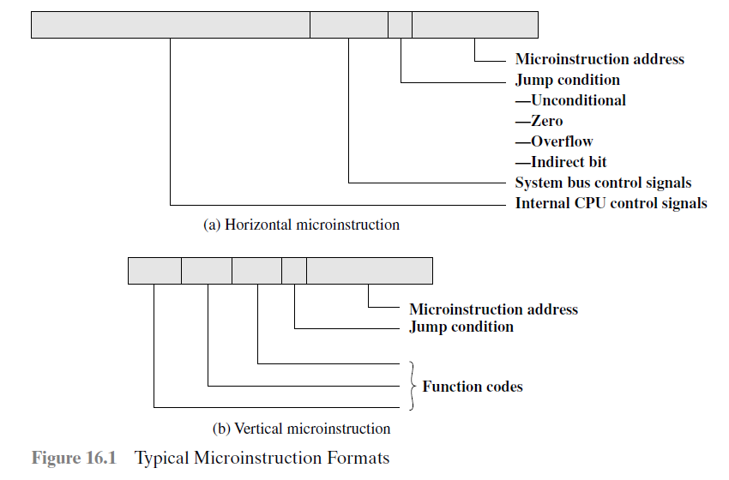
Typical Microinstruction Format

Slide 57
How to interpret a microinstruction ?
A microinstruction is interpreted as follows:
To execute this microinstruction, turn on all the control lines indicated by a 1 bit; leave off all control lines indicated by a 0 bit. The resulting control signals will cause one or more micro-operations to be performed.

Slide 58
How to interpret a microinstruction ?
If the condition indicated by the condition bits is false, execute the next microinstruction in sequence.
If the condition indicated by the condition bits is true, the next microinstruction to be executed is indicated in the address field.

Slide 59
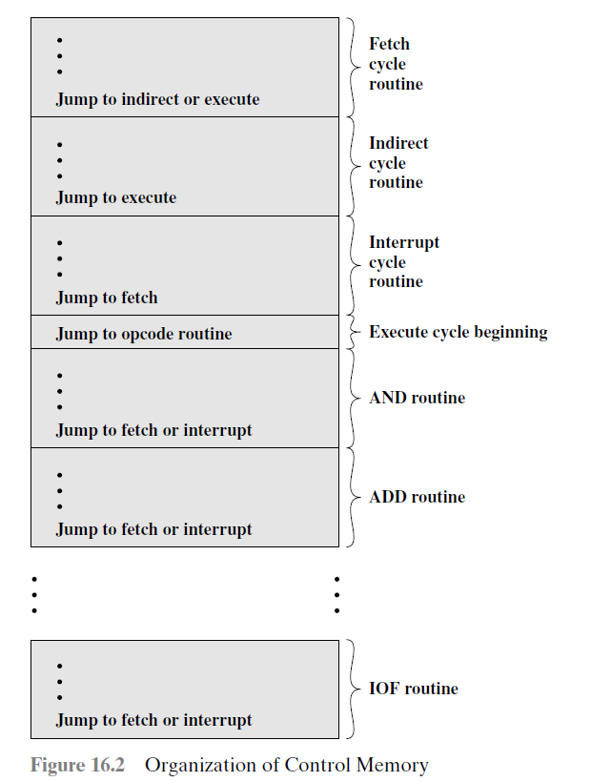
Control Memory
It specifies the sequencing of these cycles. If nothing else, this notation would be a useful device for documenting the functioning of a control unit for a particular computer.
It is also a way of implementing the control unit.

Slide 60
Control Memory
A concise description of the complete operation of the control unit.
It defines the sequence of micro-operations to be performed during each cycle (fetch, indirect, execute, interrupt).

Slide 61
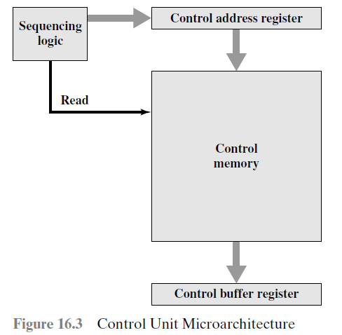
Microprogrammed Control Unit
The set of microinstructions is stored in the control memory.
The control address register contains the address of the next microinstruction to be read.
When a microinstruction is read from the control memory, it is transferred to a control buffer register.

Slide 62
Microprogrammed Control Unit
The left-hand portion of that connects to the control lines emanating(源自) from the control unit. Thus, reading a microinstruction from the control memory is the same as executing that microinstruction.
The third element shown in the figure is a sequencing unit that loads the control address register and issues a read command.

Slide 63
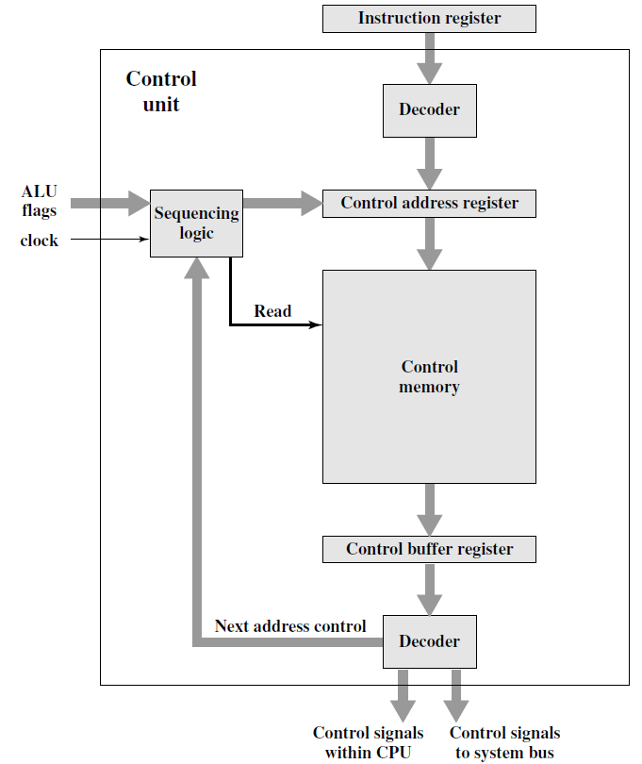
Detailed Inf.
To execute an instruction, the sequencing logic unit issues a READ command to the control memory.

Slide 64
Detailed Inf.
The word whose address is specified in the control address register is read into the control buffer register.

Slide 65
Detailed Inf.
The content of the control buffer register generates control signals and next address information for the sequencing logic unit.

Slide 66
Detailed Inf.
The sequencing logic unit loads a new address into the control address register based on the next-address information from the control buffer register and the ALU flags.

Slide 67
Microinstruction Sequencing
The two basic tasks performed by a microprogrammed control unit are as follows:
Microinstruction sequencing: Get the next microinstruction from the control memory.
Microinstruction execution: Generate the control signals needed to execute the microinstruction.

Slide 68
Microinstruction Sequencing
Two concerns are involved in the design of a microinstruction sequencing technique: the size of the microinstruction and the address-generation time.
In executing a microprogram, the address of the next microinstruction to be executed is in one of these categories:
Determined by instruction register
Next sequential address
Branch

Slide 69
Micro-instruction Execution
The microinstruction cycle is the basic event on a microprogrammed processor.
Each cycle is made up of two parts: fetch and execute.

Slide 70
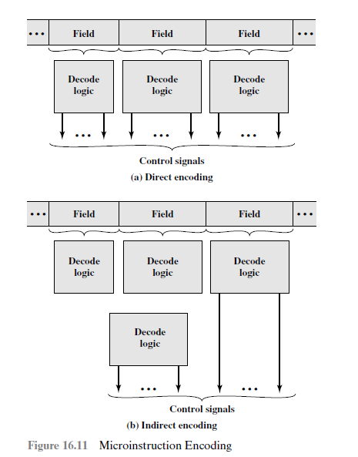
Microinstruction Encoding

Slide 71
Thank You

